Slide 1



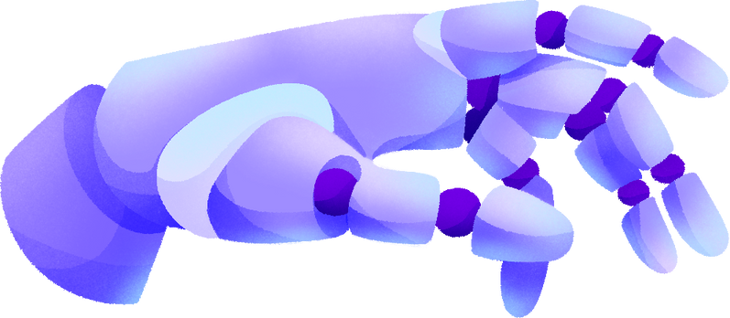

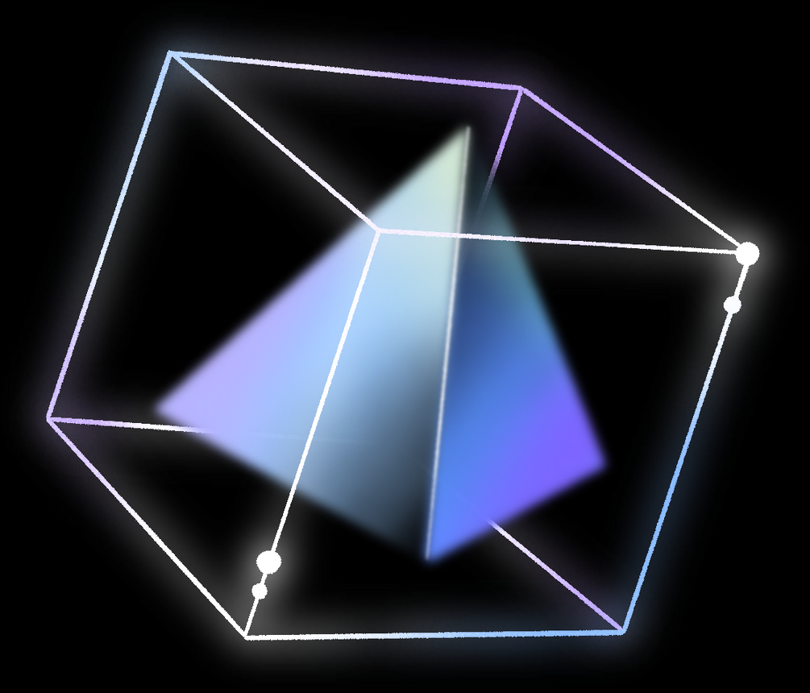
PROTOTYPE APPLICATION
MINA FRAUD ANALYSIS APPLICATION
Weesam Ammar, Victor Pinto, Sergio Reyes, Pratham Banga

Slide 2
TABLE OF CONTENTS
Motivation and Summary
Data Cleanup and Model Training
Models Summary
Model Evaluation
Discussion
Questions
01
02
03
04
05
06
07

Slide 3

MOTIVATION
AND SUMMARY
The motivation for this project was to find a sizable set of workable data that can be analyzed using different machine learning models to test its accuracy and predictability
The team found a large database of financial data that included banking information aiming to detect whether a transaction was or was not money laundering. The dataset was further trimmed down to a sufficiently sizable but workable set on which different machine learning models could be run.

Slide 4





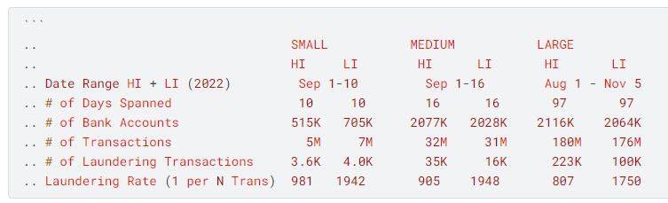

ORIGINAL DATASET
Synthetic transaction data generated to simulated an entire financial ecosystem.
Data generated by IBM to replicated the entire money laundering cycle:
Placement: Sources like smuggling of illicit funds.
Layering: Mixing the illicit funds into the financial system.
Integration: Spending the illicit funds.
SOURCE: HTTPS://WWW.KAGGLE.COM/DATASETS/EALTMAN2019/IBM-TRANSACTIONS-FOR-ANTI-MONEY-LAUNDERING-AML

Slide 5

DATA CLEAN UP AND TRAINING
01
02
03
04
Original dataset of money laundering data contained over 453MB or over 5 million lines of data. We initially tried to run the data on Jupyter Lab or Google Collab and on both instances, the laptops could not handle the data size
On a 2nd stage to clean up the data we halved the dataset but still was too large for the laptops to handle
Finally, we used the following python code to get a significantly reduced but meaningful sample of the dataset to run the models:
sample = data_df.sample(frac =.020)
Using slight variations per each model, we run training of the dataset on the numeric columns of the information

Slide 6


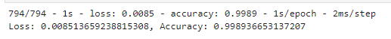
MACHINE LEARNING: NEURAL NETWORKS
Model description
A Neural Network model was applied to the dataset
The model was applied to the four numeric values of the dataset: Bank of origin (“From Bank”), Bank of destination (“To Bank”), “Amount Received” and “Amount Paid”
Results
After training and testing the data, the results showed a high level of accuracy of the model

Slide 7

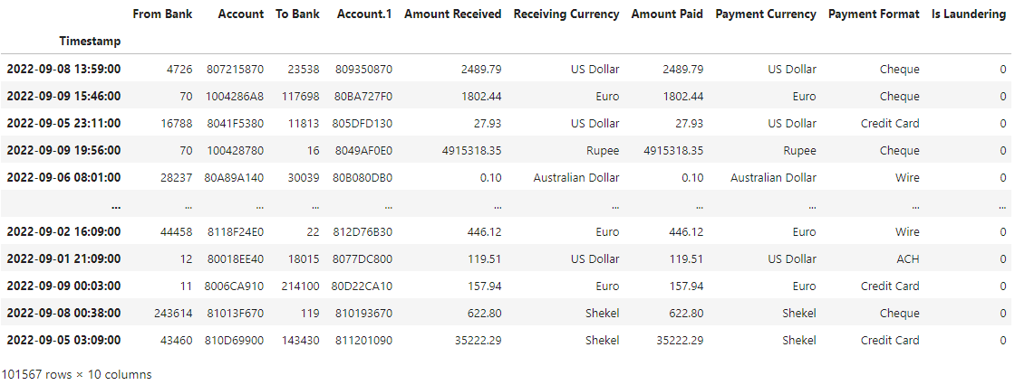
MACHINE LEARNING: NEURAL NETWORKS
Sample Dataset

Slide 8
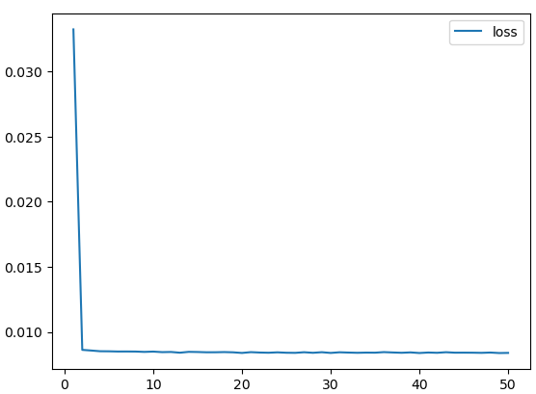
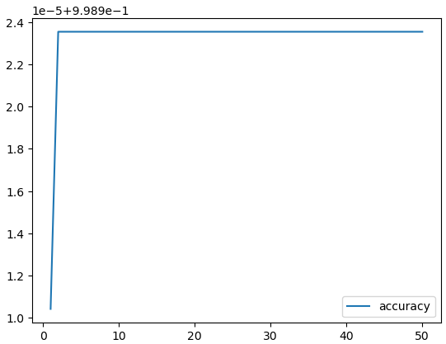
MACHINE LEARNING: NEURAL NETWORKS
Graph Results

Slide 9
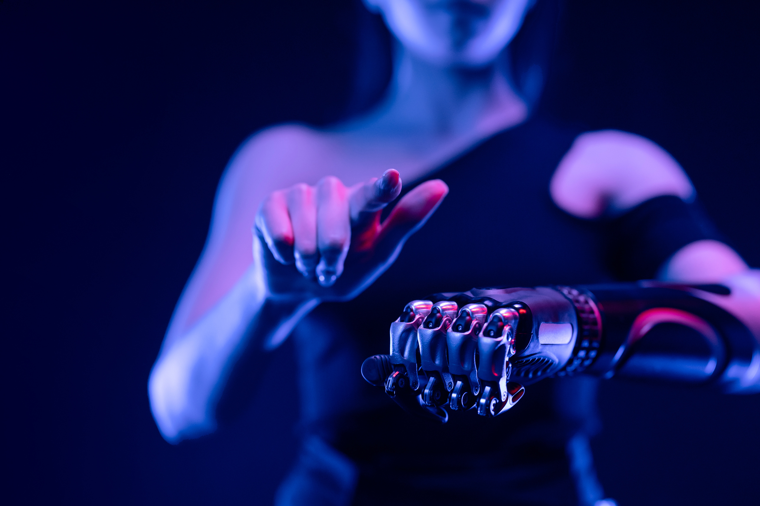
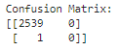

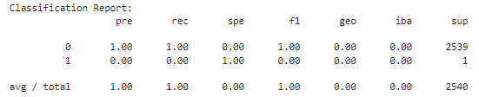

MACHINE LEARNING: SUPERVISED LEARNING
Model description
The model aims to learn a mapping between inputs and labels during training, enabling it to predict labels for new, unseen data. Common types include regression models for continuous outcomes and classification models for categorical outcomes.
Results
After testing the model here are the results:

Slide 10




STATISTICAL ANALYSIS
Based off the data, what information can we extract to deepen on understanding on how money laundering occurs. 3 factors were determined to create a comprehensive analysis.
01
Factor #1 - Laundering Occurrences by the Week.
Factor #2 - # of Transactions Based of Currency
Factor #3 - Common Types of Payments used for Laundering
02

Slide 11
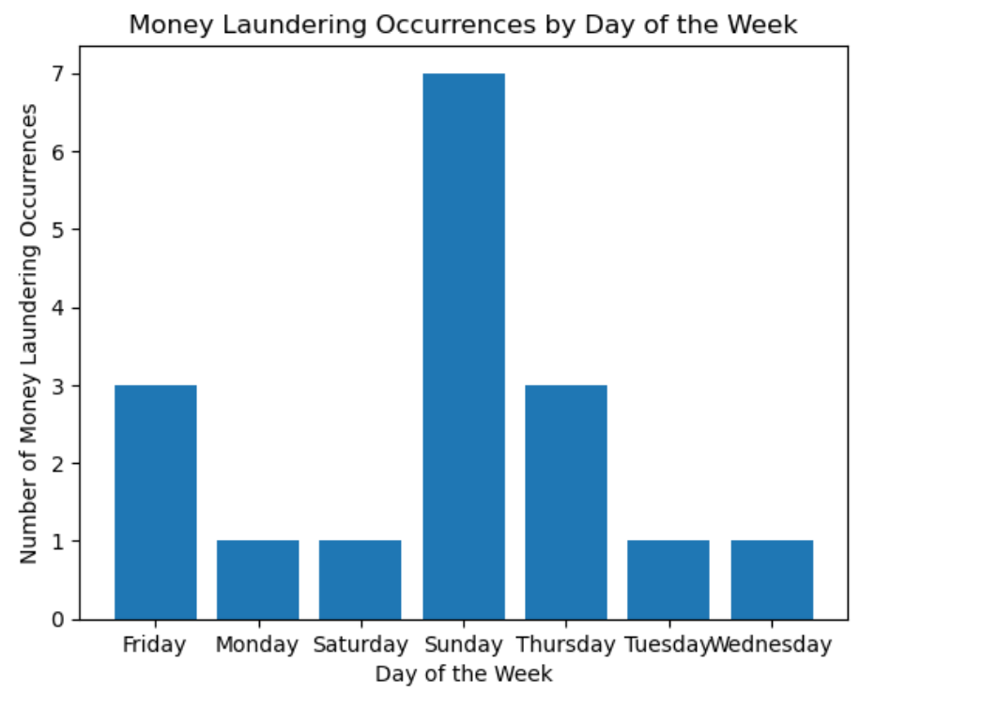


FACTOR #1

Slide 12
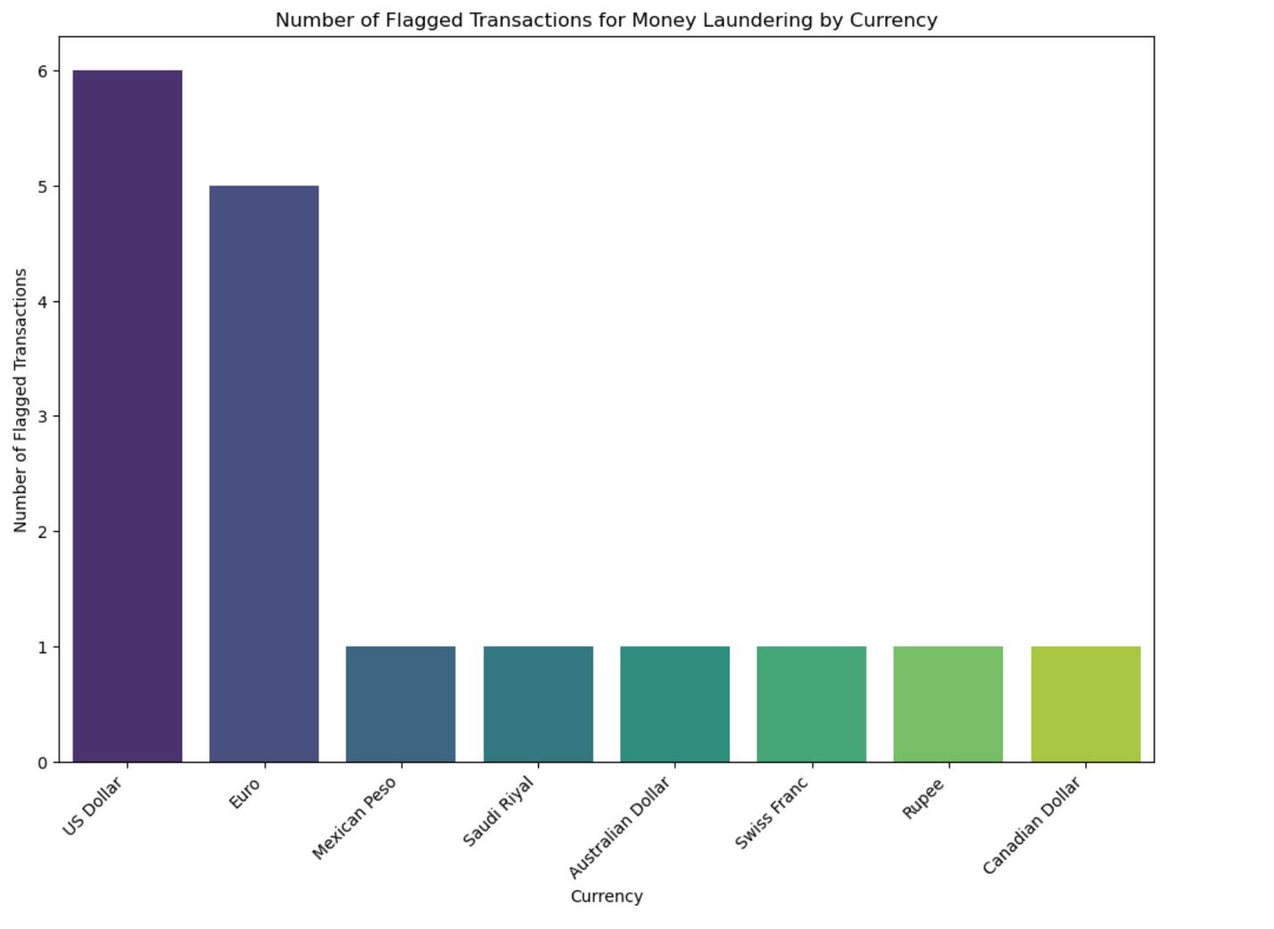
FACTOR #2

Slide 13
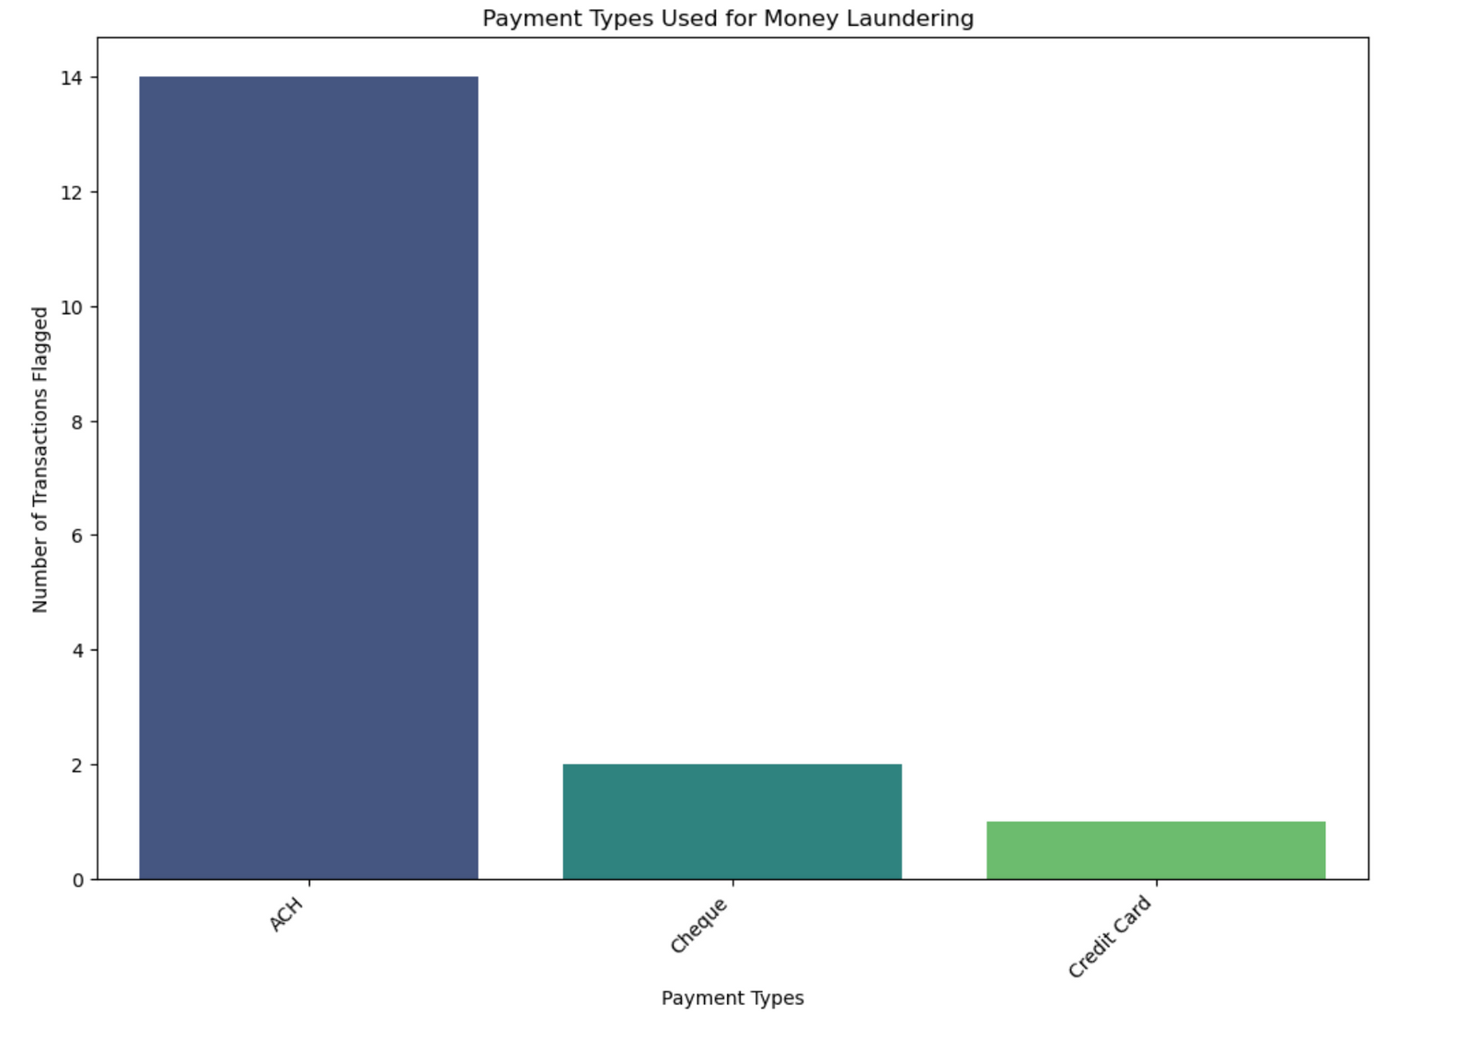
FACTOR #3

Slide 14
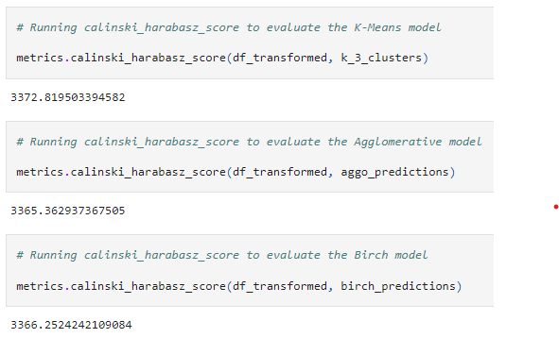
MACHINE LEARNING: UNSUPERVISED LEARNING
Model Description
The prepared model is based on two components Clustering which includes K-Means, Agglomerative and Birch models. Another is Analysis which comprises of PCA and ICA models. Furrthermore, is metrics that basically grades these models based on various components.
Results
After testing the models here are the results:

Slide 15





MODEL EVALUATION
OBJECTIVE 01
OBJECTIVE 02
OBJECTIVE 03
Advancing Time Series Analysis for finding different patterns in the dataset of financial transactions and visualizing the findings of those patterns through various tools.
Advancing Neural Network Models for training and testing the datasets plus measure the loss and accuracy while running those models and more.
Using various Unsupervised and Supervised Learning Models for Clustering, Analysis through Logistic Regressions Models and many more tools.

Slide 16
RESULTS AND FINDINGS
Here is a link for our GitHub Page to explore our findings:
HTTPS://GITHUB.COM/WEESAM01/PROJECT-2-GROUP-1.GIT

Slide 17

THANK YOU!

Slide 18



QUESTIONS

